Slide 1
Voice Recognition
in banking.
1
2
3
Project Summary
User Research
Implementation Plan

Slide 2
1
Project Summary

Slide 3


The aim.
Purpose.
Summary
The aim of this project is to successfully implement a facial recognition system into a bank’s mobile application.
A successful project will decrease friction in customer experience, increase efficiency and make them more successful in the future.
Accuracy and Speed.
Safeguards.
Key Features
To achieve efficiency, the system must identify the user in real time.
Decreasing customer friction requires that the system is not vulnerable to data breaches.
Usage of cascades to minimize operations and optimization of system through testing and iterations.
Usage of administrative, technological, and physical safeguards must be implemented and tested (eg. encription etc.)
For a good UX, system must overcome factors such as bad lighting and/or camera quality.
For a good UX, integrity and access must be a priority in the implemetation of the system.
Testing scaleFactor in function, turning images to grayscale, increasing brightness if required. FR must be an alternate verification method, password must always be an option too.
Allow users to be able to change their data (update perhaps incorrect information) and/or delete their facial recognition data.
Liveness Detection.
Transparency and consent.
A risk that needs be overcome is that people could just use a picture of you to access your account.
Users must trust the bank with their biometric information, transparency and consent must be prioritized for a good UX.
Implementation of liveness detector in face recogntion software (like Apple’s Face ID does. Furthermore, automatically log a user out if they are logged in on another device.
Transparency - Provide users with meaningful information of how the data will be used and stored.
Consent – Not everyone will feel comfortable sharing this information, get consent from each users before implementing.

Slide 4
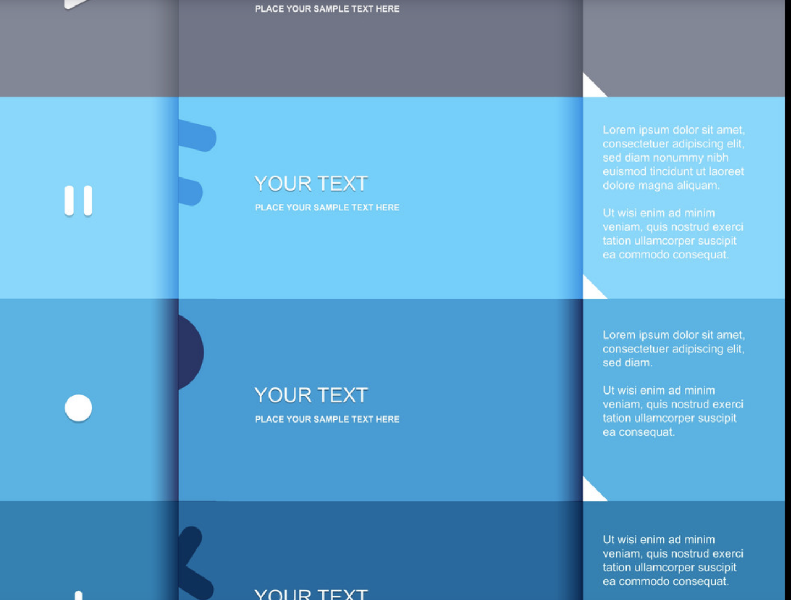
2
User Research

Slide 5



Relevant User Personas
Michael Adams
Liz Bloomberg
John Phillips
Agnes Maynard
28 • Pioneer
35 • Pragmatist
48 • Skeptic
77 • Traditionalist
Tech Savvy + relies on smartphone for most transactions.
She conform as long as she are being provided what she needs.
He is not always very happy with the service provided by the bank.
Gradually losing trust in her bank provider.
Relatively good wage.
Average wage for her age group.
High salary and very cautious with his money.
Average pension but has a lot of savings in her account.
Willing to take risks to improve his life.
She is broadly satisfied with her bank provider.
Tech wary and difficult to convince.
Usually doesn’t use application and is very tech wary.
Trusts insititutions but is nonetheless likely to change banks.
She trusts her bank but is catious about her data privacy.
Frustrated with customer service.
Very cautious about security, open to making changes to improve it.

Slide 6



Opportunities and User Stories
Michael
Liz
John
Agnes
How might we ensure pioneers like Michael build trust with the bank and make them feel we imrove their life?
How might we convince pragmastics like Liz that the FR system will improve her data privacy and efficiency?
How might we remove the doubt in skeptics like John that the FR system will not compromise their privacy?
How might we regain the trust of traditionalists like Agnes and allow her to feel at ease with the FR Tech?
As Michael, I want to use accurate facial recognition without risks so that my day to day life is more efficient.
As Liz, I want to understand how my biometric data will be used so that I feel comfortable using it and benefit from its efficiency.
As John, I want to have easy control over my biometric data so that I am not skeptical about its missusage and satisfied with my privacy.
As Agnes, I want an application that is easy to use and secure to so that I can easily and safely access my financial information.
Accept Criteria
Accept Criteria
Accept Criteria
Accept Criteria
Real-time detection and verification.
Customer satisfaction with transparency.
Ask for clear consent before implementation.
Seamless face detection that requires minimal interaction.
Accurate liveness detection, pictures of user should not be accepted.
Open information to how the data is stored.
Ability to easily update their biometric information.
Accurate liveness detection, pictures of users should not be accepted.
Adaptable to lighting/camera quality.
Database highly protected from data breaches.
Ability to easily delete their biometric information.
Database highly protected from data breaches.
Password protected too.

Slide 7
3
Implementation Plan

Slide 8
The team
The plan
Features Backlog
1
Project Manager
2
IT Architect
1
Sprint Backlog
Plan project, estimate cost and supervise every sprint process.
Plan project, estimate cost and supervise every sprint process.
Accurate face recognition system.
Implementation of liveness detection.
Increasing cybersecurity of database.
Designing UI Interface for control and consent to FR System.
To track the progress of each sprint and the implementation of the features.
2
3
AI Developers
4
UX Designers
Deep learning skills to optimize the recognition network.
To create an accessible UI and carry out user research.
Sprint
5
Android Developers
6
iOS Developers
1-4 Weeks
Java/Python skills for app on Androidmobile devices.
Swift/Python skills for app on iOS mobile devices.
Feature Release
7
Testers
8
DevOps Engineers
Final check by DevOp engineer. Implementation of feedback gathering system for continued iterations.
Carry out efficient testing and even test driven development.
Oversee code releases and deployments.
Daily Scrum
3
24h

